Slide 1
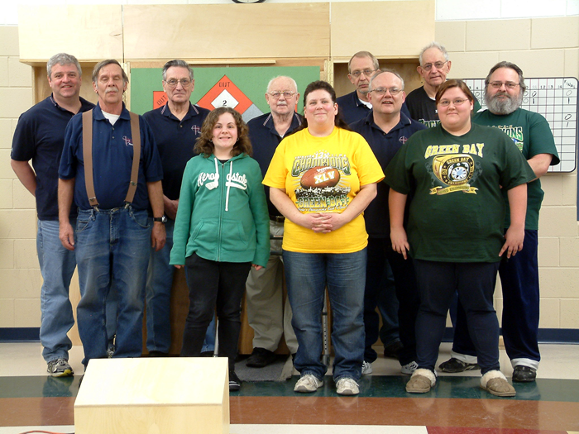
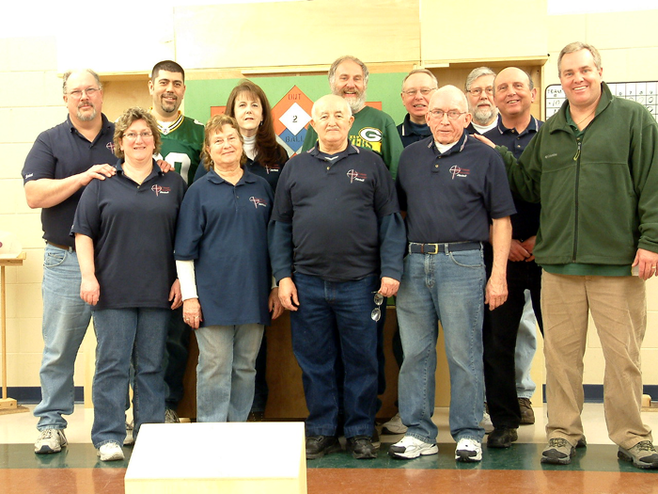
Hales Corners
Dart Ball Team #11
Hales Corners
Dart Ball Team #10

